Slide 1
Indian Agriculture crop production
India is the second largest producer of wheat and rice, the world’s major food staples.
India is currently the world’s second largest producer of several dry fruits, agriculture-based textile raw materials, roots and tuber crops, pulses, farmed fish, eggs, coconut, sugarcane and numerous vegetables.

Slide 2

Desing think

Slide 3
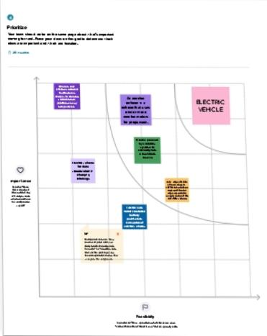
Graphical representation

Slide 4

Brainstorm ideas

Slide 5

Group ideas

Slide 6
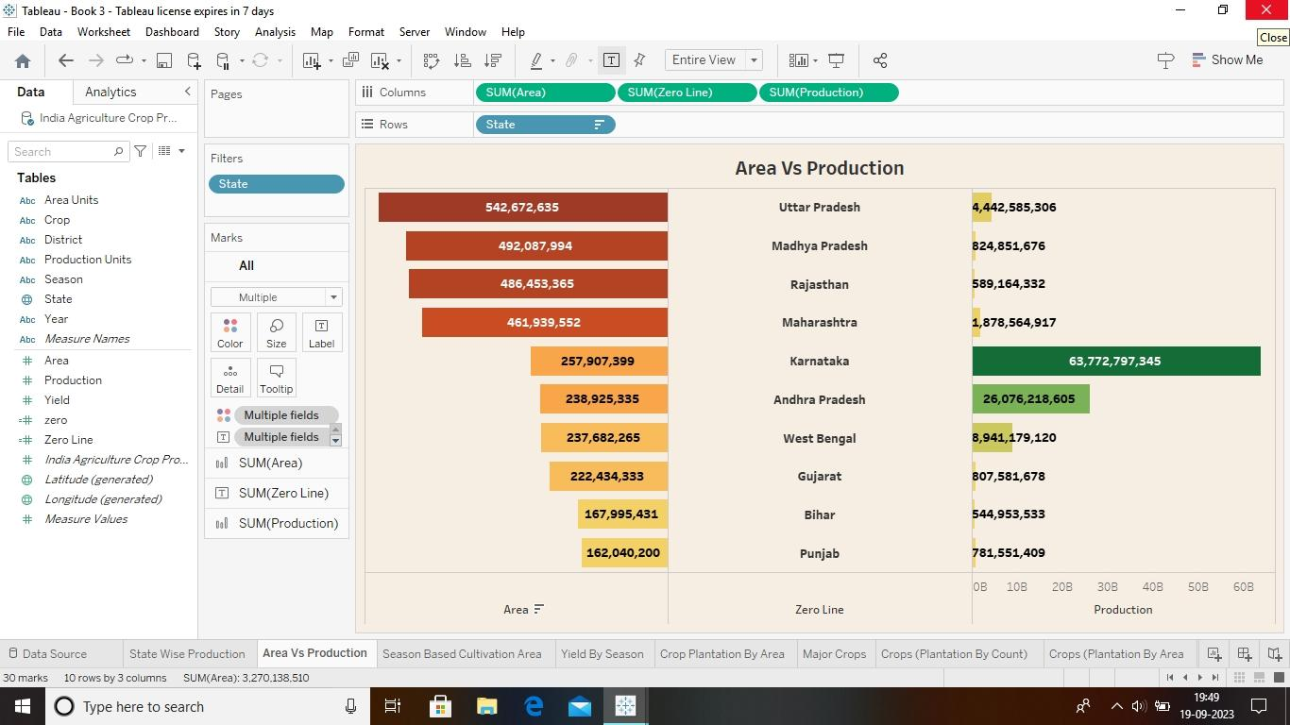
Dashboard

Slide 7
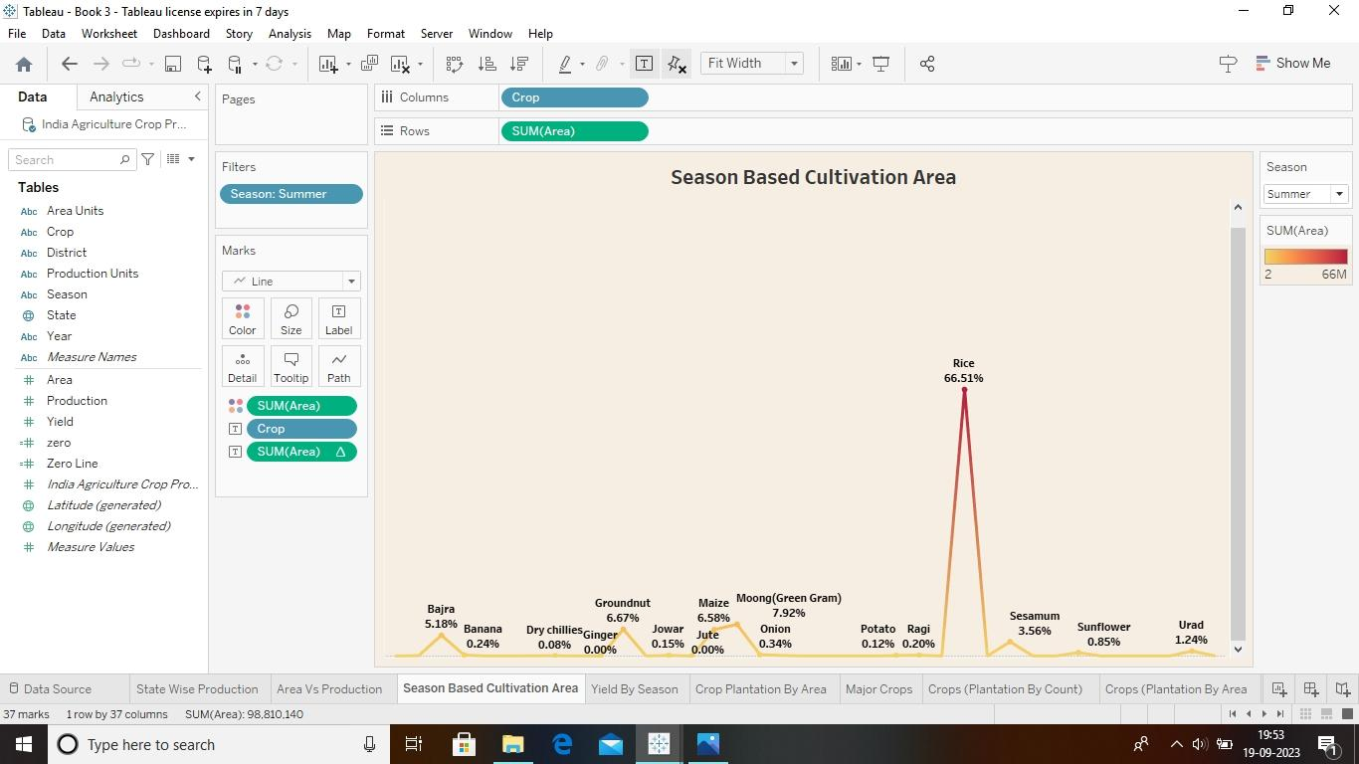

Slide 8
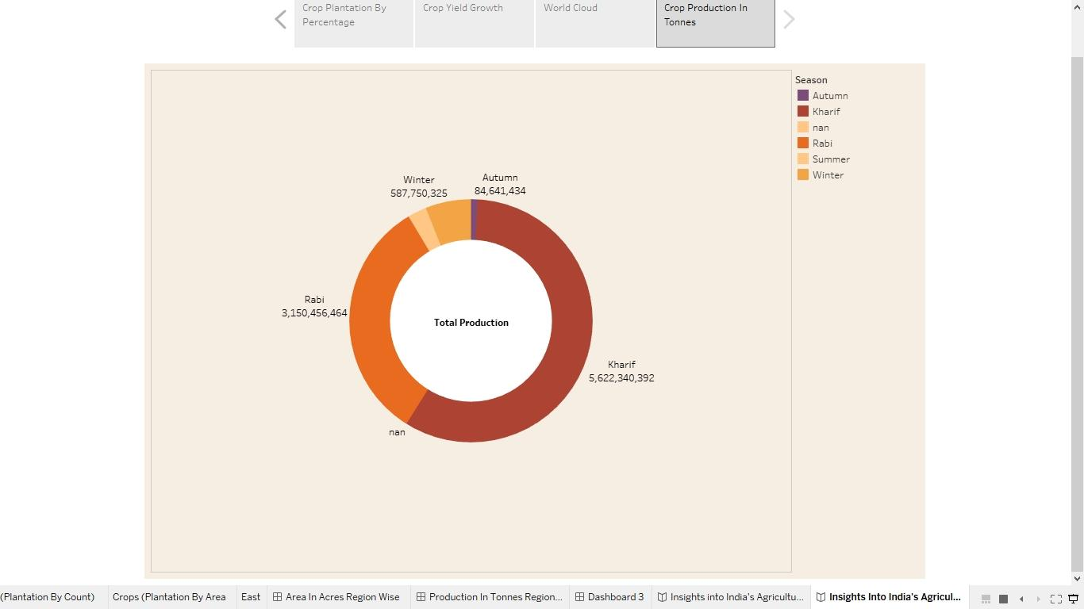

Slide 9
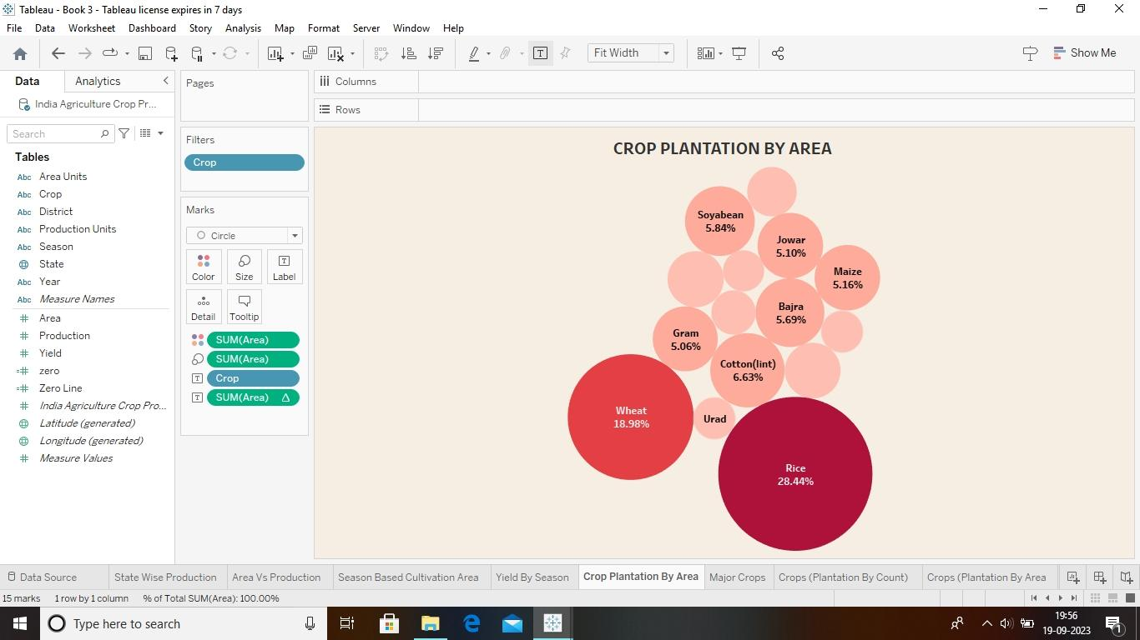

Slide 10
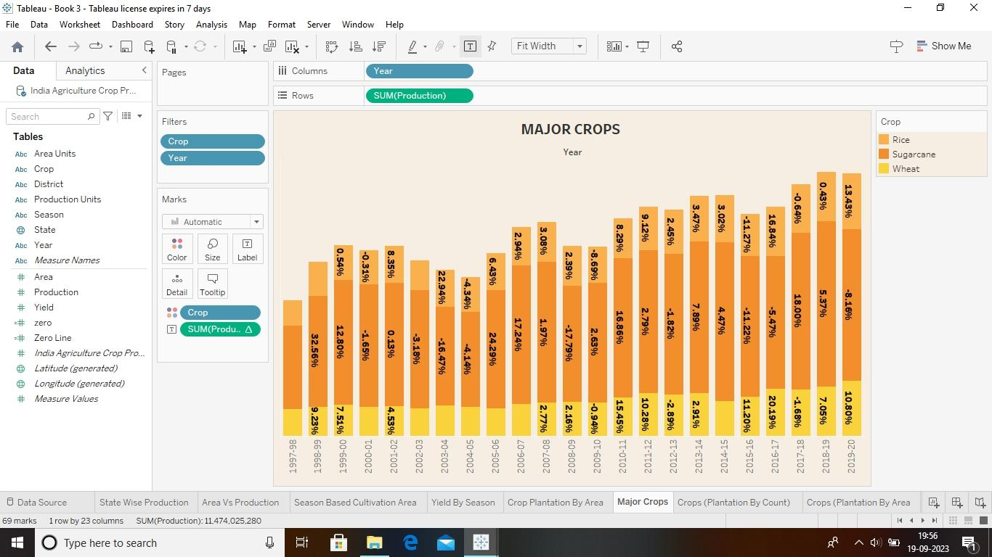

Slide 11
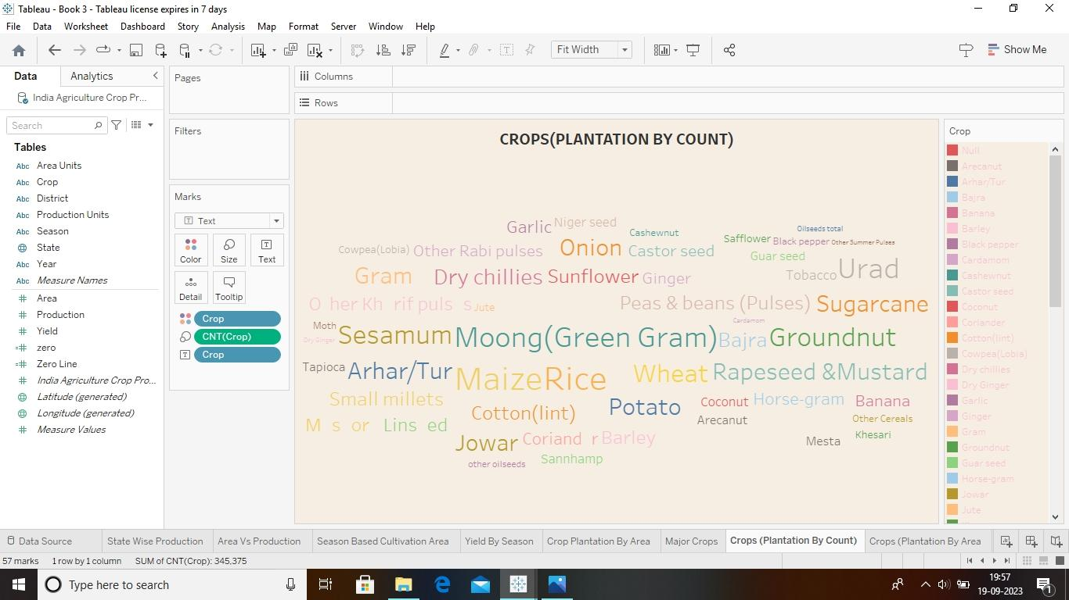

Slide 12
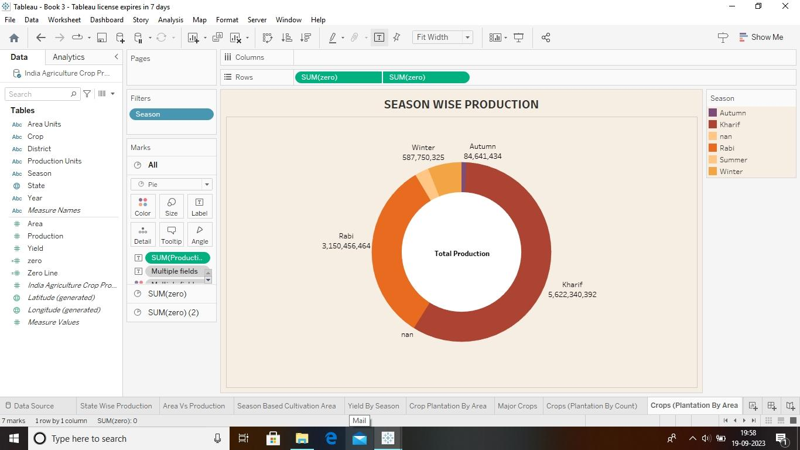

Slide 13
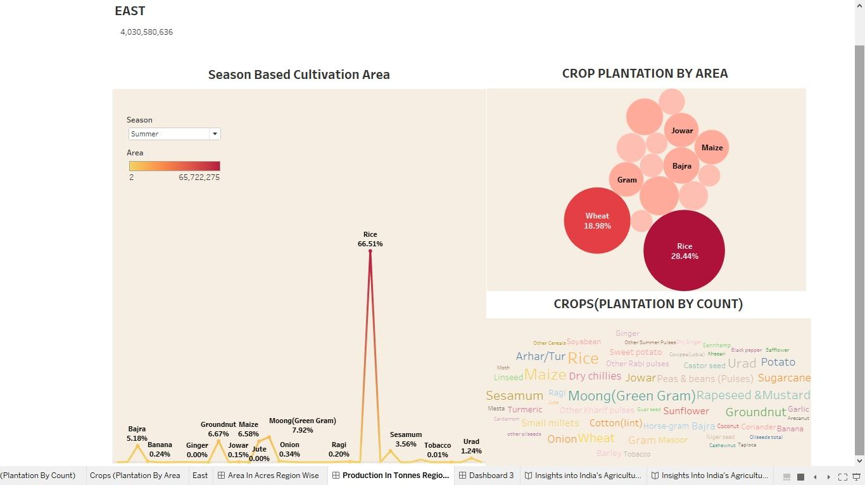

Slide 14
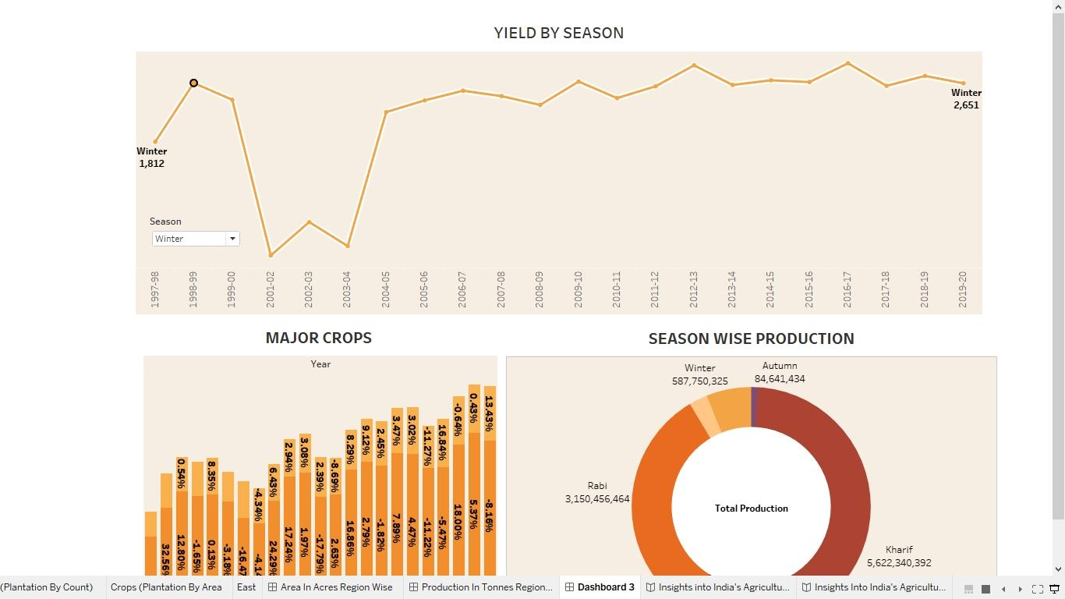

Slide 15
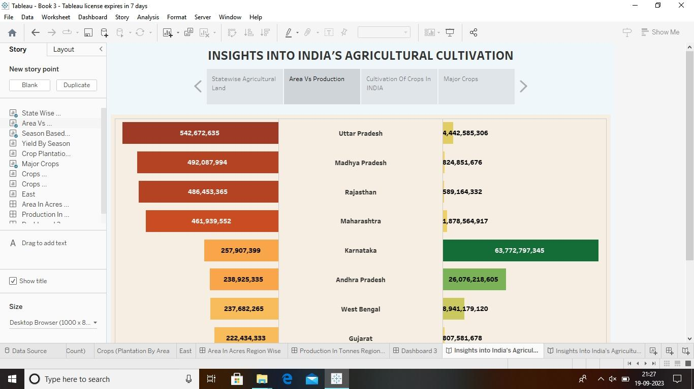
Story

Slide 16


Slide 17
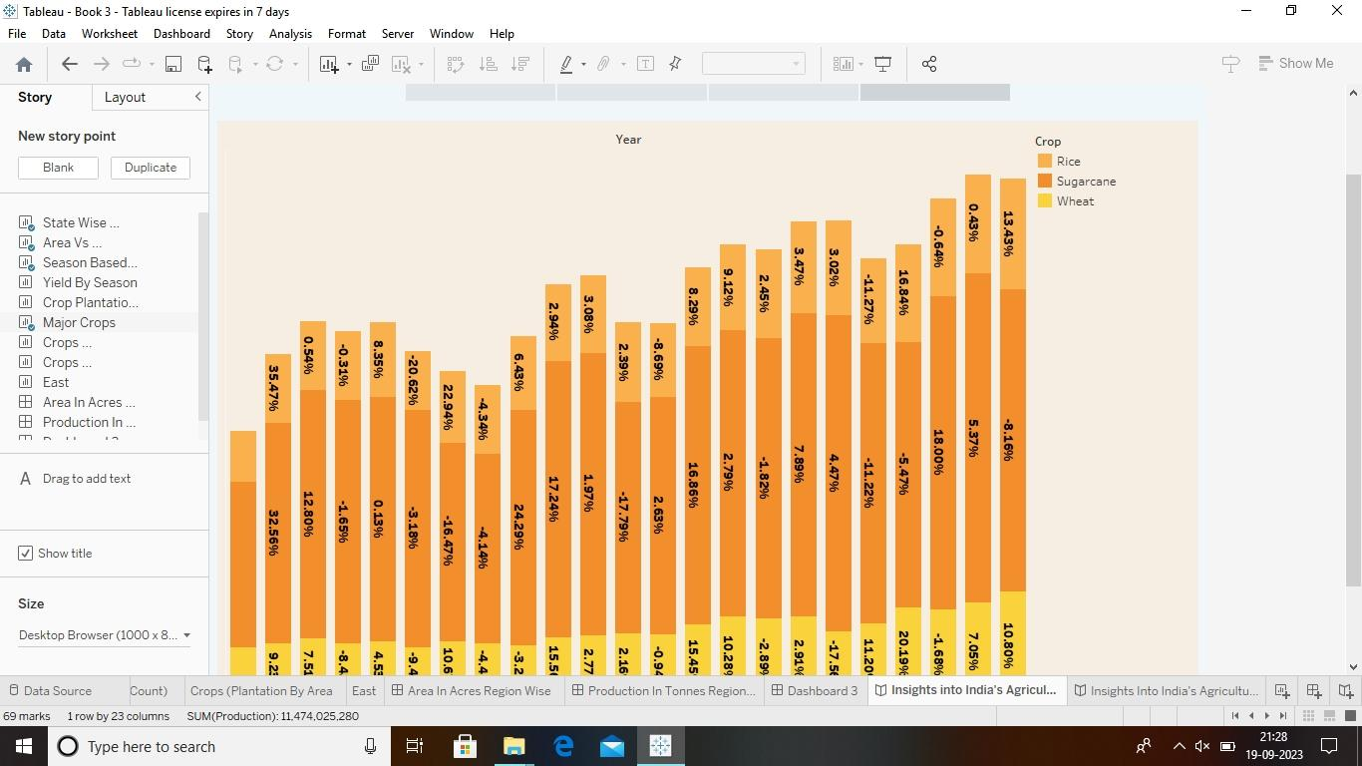

Slide 18
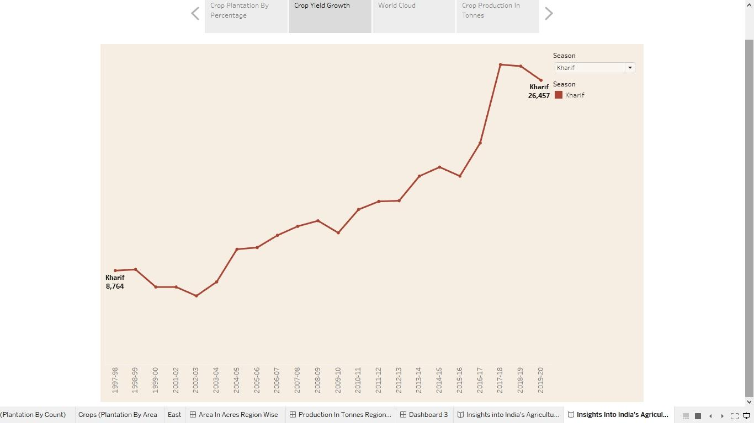

Slide 19
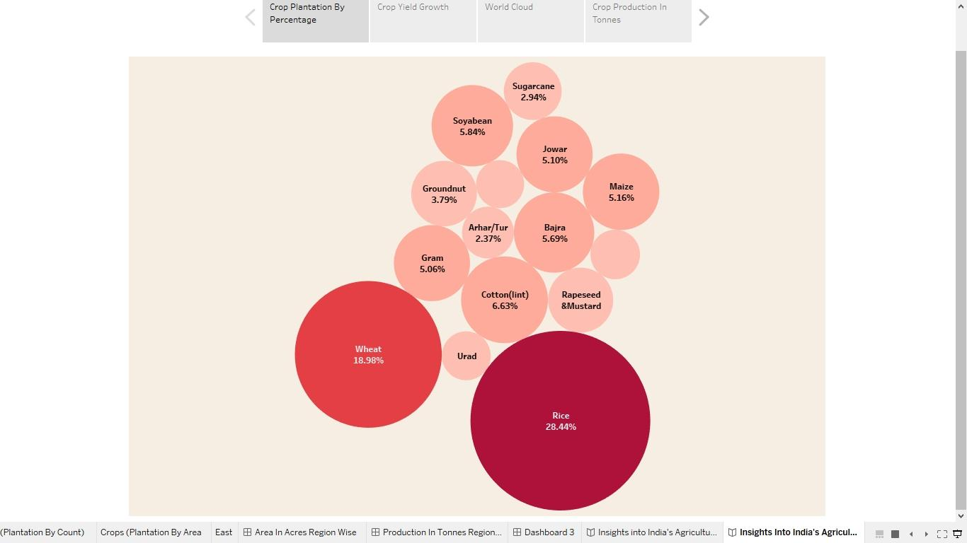

Slide 20
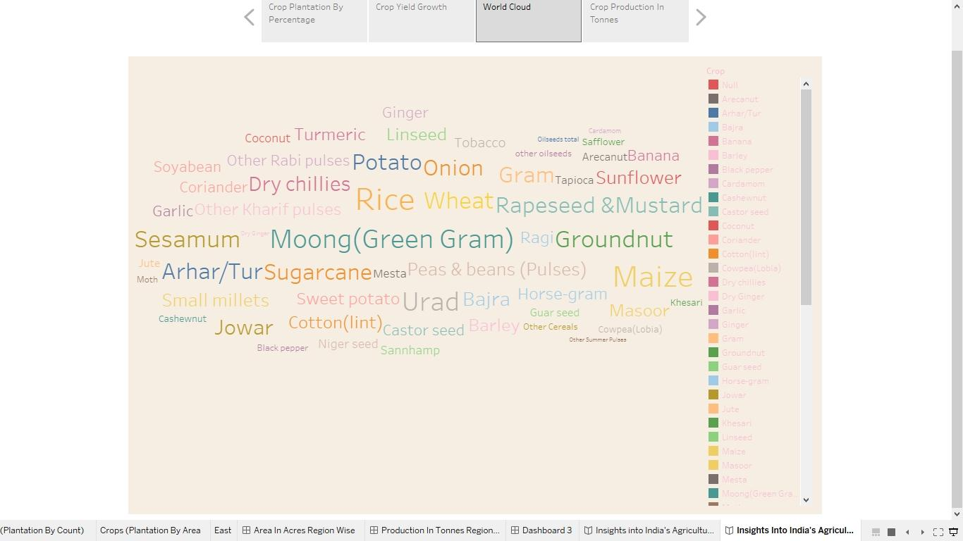

Slide 21
Summary
The Indian economy is an agro-economy and depends highly on the agricultural sector.
Despite just supporting the Indian Economy, the agricultural sector also supports the industrial sector and international trade in imports and exports.
Agriculture has given so much to society. But it has its own pros and cons that we can’t overlook. Furthermore, the government is doing his every bit to help in the growth and development of agriculture; still, it needs to do something for the negative impacts of agriculture.

Slide 22
TEAM LEADER. : C. GOWSALYA
TEAM MEMBERS. : M.ANITHA
V.VINOTHINI
L.CHITRADEVI

